Slide 1
Introducing Yasca
Michael Scovetta
Yasca Project Owner
Michael.Scovetta@gmail.com
February 2009

Slide 2
Agenda
What is Yasca?
Architecture
Plug-ins
Reporting
Demonstration
Questions?

Slide 3


What is Yasca?
(Yet Another Source Code Analyzer)
Yasca is an open-source tool for scanning source code for security, performance, and
non-conformance to best practices.
It includes other best-of-breed open-source tools (e.g. J-Lint, PMD, and FindBugs), as well as custom plug-ins.
It is written in command-line PHP, and tested on Windows and Linux.

Slide 4
What is Yasca?
(Yet Another Source Code Analyzer)
File Types Scanned:
  Java, JSP
  C/C++
  PHP
  ASP, Visual Basic
  COBOL
  HTML, JavaScript, CSS
Yasca is hosted on SourceForge, and available at http://yasca.org/

Slide 5
Architecture
Yasca is both an engine and a framework for conducting file analyses.
The engine takes a set of files and passes each one to every included plug-in, parses its output and creates a report.
Plug-in
Yasca
Report Generator
Plug-in
Plug-in
Output
/tmp/my_source_code

Slide 6
Plug-ins
Major plug-ins included in Yasca distribution:
  PMD
  FindBugs
  J-Lint and antiC
  Grep (custom-written)
Additional plug-ins are included, written as PHP scripts.
Easy to write new plug-ins (<< 5 minutes)

Slide 7
Plug-ins
Sample Plug-in:
name = String Equals Vs '=='
file_type = java
grep = /([\!=]=\s*\")/
category = Code Quality: Incorrect Usage of == or !=
severity = 2
description =
<p> Using the == or != operators should never be used to compare String content. This is
because of how Java allocates String objects, and can be illustrated with the following
example:
<code>
System.out.println("foo" == new String("foo"));
</code>
If you run this code, you will see that the output is <b>false</b>.
</p>
<p>
<h4>References</h4>
<ul>
<li>TODO</li>
</ul>
</p>
END;

Slide 8
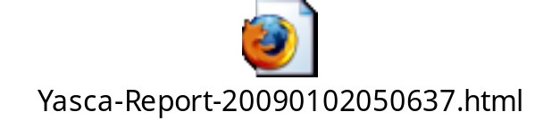
Reporting
A number of different reports are available:
  CSV
  XML
  Detailed HTML
  Simple HTML
Sample:

Slide 9
Demonstration

Slide 10

Questions?

